Slide 1
UTHRA KUMAR.A
Final Project
Kvcet
au421221104051
3rd Year B.E-CSE
Email id: uthra1742003@gmail.com
3/21/2024 Annual Review

Slide 2
PROJECT TITLE
Text-to-Image Synthesis
3/21/2024 Annual Review

Slide 3


AGENDA
PROBLEM STATEMENT
PROJECT OVERVIEW
WHO ARE THE END USERS
YOUR SOLUTION AND ITS VALUE PROPOSITION
THE WOW IN YOUR SOLUTION
MODELLING
RESULTS
3/21/2024 Annual Review

Slide 4

PROBLEM STATEMENT
The problem statement for a Text-to-Image Synthesis generative AI:
"Developing a robust and efficient Text-to-Image Synthesis model that accurately generates realistic images from textual descriptions. The objective is to bridge the semantic gap between natural language descriptions and visual representations, enabling applications such as image generation from textual prompts, enhancing content creation pipelines, and aiding in data augmentation for computer vision tasks. The project aims to explore state-of-the-art generative models, optimize training strategies, and evaluate the quality of generated images through quantitative metrics and human evaluation."
3/21/2024 Annual Review

Slide 5

PROJECT OVERVIEW
“The project aims to develop an AI model capable of generating realistic images from textual descriptions, addressing the challenge of bridging the gap between language and visual representations. This involves exploring advanced generative models, refining training techniques, and evaluating the quality of synthesized images to enhance various applications such as content creation and data augmentation for computer vision tasks."
3/21/2024 Annual Review

Slide 6

WHO ARE THE END USERS?
Content Creators
Designers and Artists
E-commerce Platforms
Game Developers
Researchers and Academia
Social Media Platforms
Accessibility Tools Users
3/21/2024 Annual Review

Slide 7

YOUR SOLUTION AND ITS VALUE PROPOSITION
Advanced generative models, efficient training strategies, robust quality assurance mechanisms, user-friendly interfaces, customization options, seamless integration capabilities, and transformative solutions
That streamline content creation processes, enhance creativity, and improve user engagement across various industries and domains.
3/21/2024 Annual Review

Slide 8

THE WOW IN YOUR SOLUTION
Its ability to seamlessly transform textual descriptions into stunning, lifelike images, empowering users with unprecedented creativity and efficiency in content creation, marketing, product visualization, and accessibility enhancement
3/21/2024 Annual Review

Slide 9
MODELLING
Architecture: Choose GANs or VAEs.
Data Representation: Convert text to embeddings and preprocess images.
Model Integration: Combine text embeddings with image generation.
Loss Function: Use adversarial and reconstruction losses.
Training: Employ progressive training and optimize hyperparameters.
Evaluation: Measure with FID, Inception Score, or human evaluation.
Fine-tuning: Refine model based on evaluation results.
Deployment: Consider computational constraints for deployment.
3/21/2024 Annual Review

Slide 10
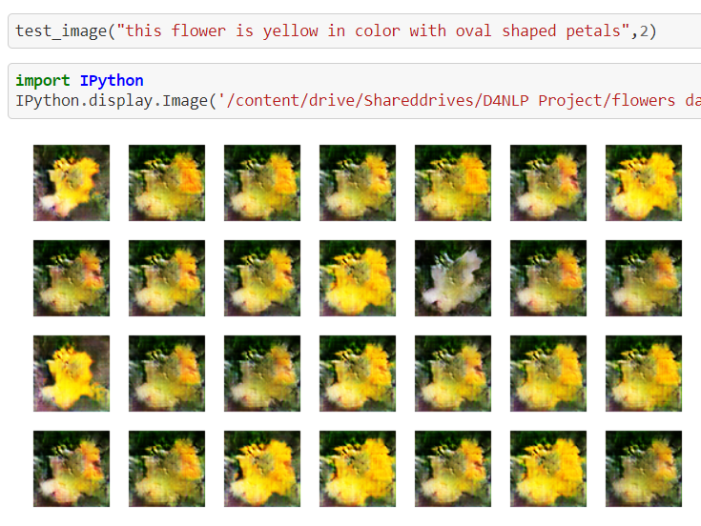
RESULTS
Demo Link
3/21/2024 Annual Review

